Slide 1

ME23312 ENGINEERING THERMODYNAMICS
Unit III – Properties of Pure Substance · Presentation 10 of 10
Flow Processes of Steam and the Application of the Two Laws
SFEE with steam · turbine and isentropic efficiency · nozzle · throttling · adiabatic mixing · entropy generation and feasibility · availability of steam · Unit III formula sheet
Dr. Anantha Raman L., M.E., Ph.D. · Associate Professor, Department of Mechanical Engineering, Rajalakshmi Institute of Technology, Chennai

Slide 2

In this presentation
The SFEE with steam
Steam turbine – ideal and actual
Isentropic efficiency
Steam nozzle
Throttling
Adiabatic mixing of steam streams
First law – closed and open systems
Second law – entropy of steam and feasibility
Availability of steam
Unit III formula sheet
ME23312 Engineering Thermodynamics · Unit III · Presentation 10
2

Slide 3
Flow processes of steam
1
ME23312 Engineering Thermodynamics · Unit III · Presentation 10
3

Slide 4
The SFEE with steam
Boilers, turbines, nozzles, condensers, valves and mixing chambers: h₁ + V₁²/2 + gz₁ + q = h₂ + V₂²/2 + gz₂ + w
Enthalpies from the steam tables or the Mollier chart; the potential-energy term is always negligible
The governing property is the enthalpy, not the internal energy
The ideal (reversible adiabatic) process is isentropic – a vertical line on the h–s chart
ME23312 Engineering Thermodynamics · Unit III · Presentation 10
4

Slide 5
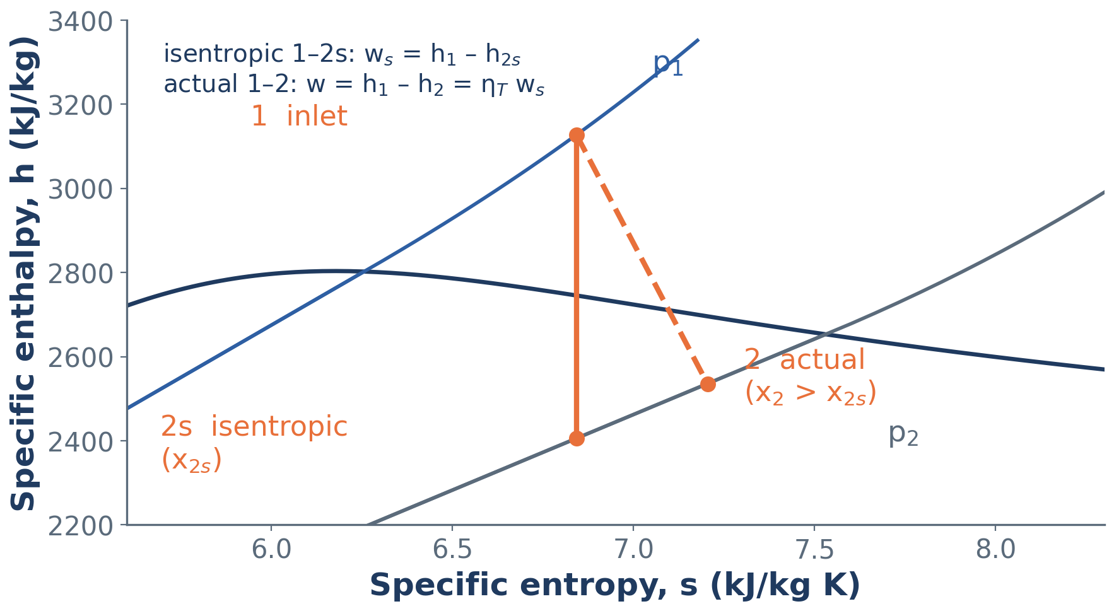
Turbine expansion on the h–s diagram
Isentropic expansion 1–2s is the vertical drop; the actual exhaust 2 lies to the right, with less work and a higher dryness fraction
ME23312 Engineering Thermodynamics · Unit III · Presentation 10
5

Slide 6
Steam turbine
Insulated casing (q ≈ 0), small velocities: w = h₁ – h₂
Ideal turbine: s_{2s} = s₁; if s₁ lies between s_{f} and s_{g} at p₂ the exhaust is wet: x_{2s} = (s₁ – s_{f2})/s_{fg2}, h_{2s} = h_{f2} + x_{2s} h_{fg2}
Ideal work w_{s} = h₁ – h_{2s} – the vertical drop on the Mollier chart
Real turbine: friction and turbulence raise the exhaust entropy – state 2 lies to the right of 2s and the work is smaller
ME23312 Engineering Thermodynamics · Unit III · Presentation 10
6

Slide 7
Isentropic (adiabatic) efficiency of a turbine
η_{T} = actual work / isentropic work = (h₁ – h₂)/(h₁ – h_{2s})
h₂ = h₁ – η_{T} (h₁ – h_{2s})
Actual exit dryness x₂ = (h₂ – h_{f2})/h_{fg2} is higher than x_{2s} – the energy not converted to work stays in the steam and re-evaporates some moisture
Entropy generated per kg: s_{gen} = s₂ – s₁ > 0 (adiabatic)
ME23312 Engineering Thermodynamics · Unit III · Presentation 10
7

Slide 8
Steam nozzle
V₂ = √[2 (h₁ – h_{2s})] (h in J/kg)
V₂ = 44.72 √(h₁ – h_{2s}) (h in kJ/kg, V in m/s)
A₂ = ṁ v₂/V₂, v₂ = v_{f2} + x₂ v_{fg2}
Enthalpy drop → kinetic energy; no work, no heat, no change of elevation: V₂²/2 – V₁²/2 = h₁ – h₂
Ideal nozzle: isentropic expansion with negligible inlet velocity; nozzle efficiency η_{N} = (h₁ – h₂)/(h₁ – h_{2s}) for friction
ME23312 Engineering Thermodynamics · Unit III · Presentation 10
8

Slide 9
Throttling
Partly open valve, orifice or porous plug: large pressure drop, no work, no heat, negligible velocity change ⇒ h₁ = h₂
A horizontal line on the Mollier chart: wet steam becomes drier and eventually superheated; superheated steam becomes cooler (steam is not an ideal gas)
Highly irreversible: s₂ > s₁ and the pressure drop is lost
Uses: throttling calorimeter, pressure-reducing valves, refrigerator expansion valve, throttle governing of turbines
ME23312 Engineering Thermodynamics · Unit III · Presentation 10
9

Slide 10
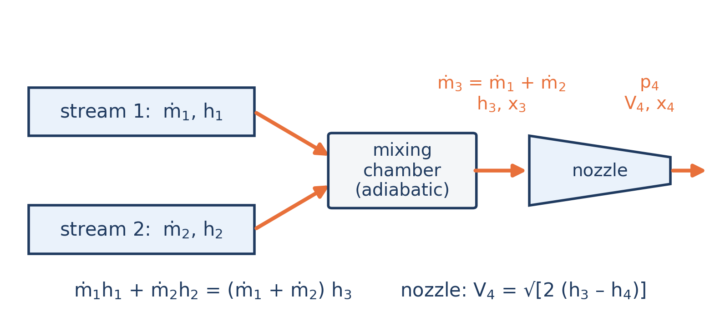
Adiabatic mixing of steam streams
Two streams at the same pressure mix in an insulated chamber with no work; the mixture may then expand in a nozzle
ME23312 Engineering Thermodynamics · Unit III · Presentation 10
10

Slide 11
Adiabatic mixing
ṁ₁ + ṁ₂ = ṁ₃ ṁ₁h₁ + ṁ₂h₂ = ṁ₃h₃
h₃ = (ṁ₁h₁ + ṁ₂h₂)/(ṁ₁ + ṁ₂)
Mixture state fixed by p and h₃: h₃ < h_{g} → wet, x₃ = (h₃ – h_{f})/h_{fg}; h₃ > h_{g} → superheated, T by interpolation
Irreversible: Ṡ_{gen} = ṁ₃s₃ – ṁ₁s₁ – ṁ₂s₂ must be positive; desuperheaters and feed-water heaters work this way
ME23312 Engineering Thermodynamics · Unit III · Presentation 10
11

Slide 12
The first and second laws applied to steam
2
ME23312 Engineering Thermodynamics · Unit III · Presentation 10
12

Slide 13
First law
Closed systems (non-flow)
Open systems (steady flow)
Q = m (u₂ – u₁) + W, W from the process law
u = h – pv, or u_{f} + x u_{fg} for wet steam
Constant V: Q = mΔu; constant p: Q = mΔh; isentropic: W = –mΔu
q – w = Δh + ΔV²/2
Turbine w = h₁ – h₂; nozzle V₂ = √[2 (h₁ – h₂)]
Throttling h₁ = h₂; boiler, condenser q = h₂ – h₁; mixing Σ ṁh in = Σ ṁh out
ME23312 Engineering Thermodynamics · Unit III · Presentation 10
13

Slide 14
Second law – entropy of steam
Entropy is read from the tables (s = s_{f} + x s_{fg} in the wet region), so Δs = s₂ – s₁ regardless of the path
Reversible process: q = ∫ T ds = area under the T–s curve; isothermal evaporation q = T_{sat} s_{fg} = h_{fg}
Reversible adiabatic = isentropic; the isentropic end state is the reference for the actual one through the isentropic efficiency
ME23312 Engineering Thermodynamics · Unit III · Presentation 10
14

Slide 15
Entropy generation and feasibility
Adiabatic device: s_{gen} = s_{out} – s_{in}
Mixing: Ṡ_{gen} = Σ ṁ_{out}s_{out} – Σ ṁ_{in}s_{in}
Heat q to surroundings at T₀: s_{gen} = (s₂ – s₁) – q/T₀
A process is possible only if s_{gen} ≥ 0; the work lost is I = T₀ s_{gen} (Unit II)
Throttling generates far more entropy than a real turbine or a mixing chamber – a wasteful way to reduce pressure
ME23312 Engineering Thermodynamics · Unit III · Presentation 10
15

Slide 16
Availability of steam
ψ = (h – h₀) – T₀ (s – s₀) η_{II} = w/(ψ₁ – ψ₂)
Dead state usually taken as saturated liquid at the atmospheric temperature
ψ gives the maximum work obtainable from the stream; the same table values serve both laws
ME23312 Engineering Thermodynamics · Unit III · Presentation 10
16

Slide 17
Checklist for any steam problem
Fix each state with two independent properties – decide wet, dry or superheated by comparing with the saturation values
Closed system → use u and Q = ΔU + W; open system → use h and the SFEE
Ideal process → s = constant; real process → isentropic efficiency, then the actual end state from h
Test the result with the second law: s_{gen} ≥ 0
ME23312 Engineering Thermodynamics · Unit III · Presentation 10
17

Slide 18
Unit III at a glance
3
Formula sheet
ME23312 Engineering Thermodynamics · Unit III · Presentation 10
18

Slide 19
Formula sheet (1) – states and properties
Triple point 0.01 °C, 0.6117 kPa; critical point 22.064 MPa, 373.95 °C, h_{fg} = 0
Degree of superheat T – T_{sat}; degree of subcooling T_{sat} – T
x = m_{g}/(m_{f} + m_{g}); v = v_{f} + x v_{fg}; h = h_{f} + x h_{fg}; s = s_{f} + x s_{fg}
u = h – pv = u_{f} + x u_{fg}; h_{fg} = T_{sat} s_{fg}
Compressed liquid ≈ saturated liquid at the same T; h ≈ h_{f} + v_{f} (p – p_{sat})
Diagrams: T–s heat = area, isentropic vertical; Mollier isentropic vertical, throttling horizontal
ME23312 Engineering Thermodynamics · Unit III · Presentation 10
19

Slide 20
Formula sheet (2) – calorimeters and processes
Separating x = m_{g}/(m_{f} + m_{g}); throttling x₁ = (h₂ – h_{f1})/h_{fg1}
Combined x = x₂ m₂/(m₁ + m₂) = x₁ x₂
Constant volume W = 0, Q = mΔu; constant pressure W = pΔV, Q = mΔh
Isothermal Q = mTΔs; hyperbolic W = p₁V₁ ln (V₂/V₁)
Isentropic W = –mΔu; polytropic W = (p₁V₁ – p₂V₂)/(n – 1)
Always Q = ΔU + W
ME23312 Engineering Thermodynamics · Unit III · Presentation 10
20

Slide 21
Formula sheet (3) – flow and the second law
Turbine w = h₁ – h₂; η_{T} = (h₁ – h₂)/(h₁ – h_{2s})
Nozzle V₂ = √[2 (h₁ – h₂)] = 44.72 √Δh; A = ṁv/V
Throttling h₁ = h₂; mixing h₃ = (ṁ₁h₁ + ṁ₂h₂)/(ṁ₁ + ṁ₂)
s_{gen} = s₂ – s₁ (adiabatic) or Σ ṁs_{out} – Σ ṁs_{in} ≥ 0; I = T₀ s_{gen}
Actual turbine exhaust is drier than the isentropic exhaust
ψ = (h – h₀) – T₀ (s – s₀); η_{II} = w/(ψ₁ – ψ₂)
ME23312 Engineering Thermodynamics · Unit III · Presentation 10
21

Slide 22
Unit III complete
Numerical problems: Worked Examples 3.1 – 3.15 and Practice Problems P1 – P8 in the lecture notes
Review questions: 30 two-mark and 17 thirteen-mark questions in the notes
Next unit: Ideal and Real Gases, Thermodynamic Relations – Unit IV
ME23312 Engineering Thermodynamics · Unit III · Presentation 10
22

